Slide 1

The Critical Gap in Rehabilitation Recovery
70% Non-Adherence Crisis
Monotonous Experience
Patients abandon prescribed home exercise programmes, severely compromising recovery outcomes
Traditional rehabilitation lacks engagement and immediate feedback, leading to patient disillusionment
Access Inequality
Rural and underserved communities face significant barriers to professional rehabilitation support

Slide 2




The Healthcare Impact: A Cascading Crisis
Compromised Recovery
Non-adherence directly correlates with delayed healing and reduced treatment efficacy
Escalating Costs
Poor compliance leads to complications, re-injuries, and expensive secondary interventions
Therapist Burnout
Valuable clinical time wasted on routine monitoring rather than high-impact patient care
Care Continuity Gap
Current systems fail to bridge the critical transition from clinic to home recovery

Slide 3
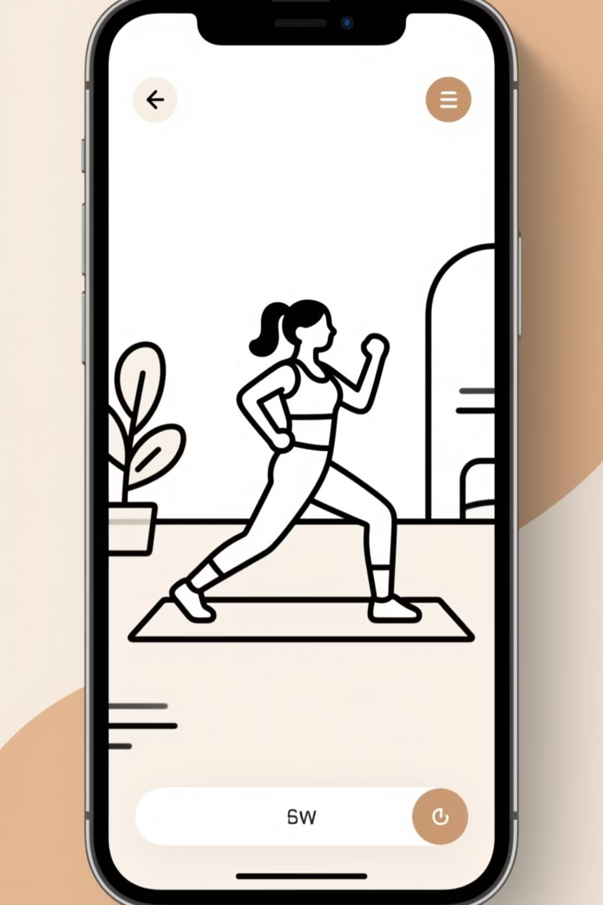
BrokenKneeCaps: Revolutionising Rehabilitation
Interactive Gamification
Universal Accessibility
Seamless Remote Care
Transform tedious exercises into engaging, achievement-driven experiences that motivate consistent participation
Leverages ubiquitous smartphone and webcam technology to deliver professional-grade rehabilitation anywhere
Enables continuous therapist-patient connection through intelligent monitoring and real-time intervention capabilities

Slide 4
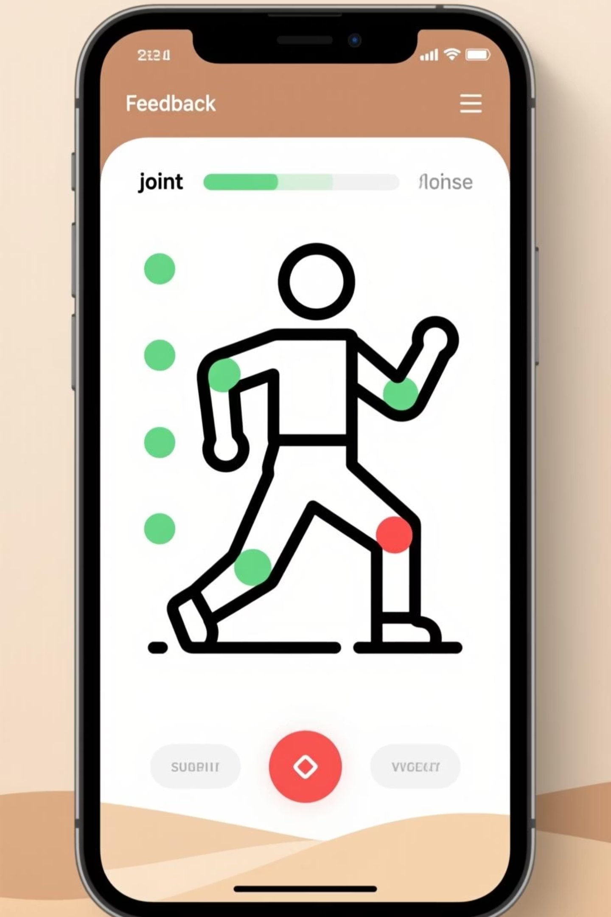
Patient Journey: Three Steps to Recovery
01
02
Motion Capture
Instant Feedback
Advanced pose estimation technology analyses joint movements through standard device cameras, creating precise biomechanical data
Real-time comparison against clinical protocols provides immediate visual cues—green for correct form, red for adjustment needed
03
Gamified Progress
Points, challenges, and achievements drive engagement whilst intelligent voice assistance provides encouraging, corrective guidance

Slide 5




Advanced Patient Features
Automated Rep Counting
ROM Measurement
Eliminates manual tracking with precision AI-powered repetition detection and validation
Quantifies range of motion improvements with clinical-grade accuracy for objective progress tracking
Progress Visualisation
Multi-Modal Feedback
Comprehensive analytics dashboard showcasing adherence rates, performance trends, and recovery milestones
Audio and visual cues guide proper form whilst preventing injury through intelligent movement analysis

Slide 6

Therapist Command Centre
Population Health Overview
Risk-stratified patient panels with instant identification of non-adherent cases requiring intervention
Granular Analytics
Comprehensive insights including adherence patterns, ROM progression curves, and form error heat maps
Remote Prescription
Seamless protocol customisation and deployment directly through the platform interface

Slide 7

Enterprise-Grade Technology Architecture
Client Layer
1
React Native/Flutter cross-platform framework with MediaPipe pose estimation for real-time on-device processing
Backend Infrastructure
2
Scalable microservices architecture deployed on Google Cloud/AWS with NoSQL database optimisation
Security & Compliance
3
End-to-end encryption, robust access controls, and full HIPAA/GDPR compliance framework
Built for healthcare scale with enterprise security standards

Slide 8
Strategic Development Roadmap
Phase 1: MVP Foundation
1
Core prototype with single exercise focus, accurate repetition counting, and basic visual feedback systems
2
Phase 2: Engagement Layer
Full gamification suite with points, achievements, ROM tracking, and comprehensive exercise timing metrics
Phase 3: Professional Integration
3
Secure therapist dashboard, advanced data visualisation, and remote protocol management capabilities
4
Phase 4: AI Enhancement
Machine learning-powered feedback refinement, secure messaging, and seamless EMR system integration

Slide 9
Market Impact & Opportunity
£50B
85%
Transformative Outcomes
Accelerated recovery rates through consistent adherence
Global Market
Cost Reduction
Reduced re-injury incidents via proper form guidance
Physical therapy market rapidly transitioning to digital solutions
Potential decrease in repeat interventions through improved compliance
Decreased healthcare expenditure for providers and patients
Enhanced quality of life through accessible, effective rehabilitation

Slide 10
The Future of Rehabilitation
Bridging the critical gap between clinical treatment and successful home recovery—ensuring no patient is left behind in their journey to full mobility.
Request Live Demo
Launch Pilot Programme
Experience our platform's core functionality and see real-time motion tracking in action
Partner with us to deploy targeted trials and measure tangible patient outcome improvements
Ready to revolutionise patient recovery? Let's discuss your implementation strategy.

